Slide 1
TMS Therapy
Tarique Perera MD
Clinical Director
Contemporary Care
Greenwich and Danbury CT
Adjunct faculty
Columbia University
Founding President, Clinical TMS Society
Notes:
Transcranial Magnetic stimulation is a cutting edge, non-invasive treatment that is FDA approved for Major Depressive Disorder. It is also a novel treatment strategy for other brain conditions including anxiety disorders (OCD, social anxiety, GAD, PTSD), chronic pain, substance abuse, eating disorders, psychosis, autistic spectrum disorders, early stages of Parkinson’s Disease, and Traumatic Brain Injury.
In the following section of my talk, I would like to discuss TMS in more detail. I will review its mechanism of action, and then discuss some of the most recent randomized clinical trial evidence supporting its efficacy and safety. I will also discuss recent outcomes in real-world practice settings obtained from an ongoing large, prospective, outcomes study.

Slide 2
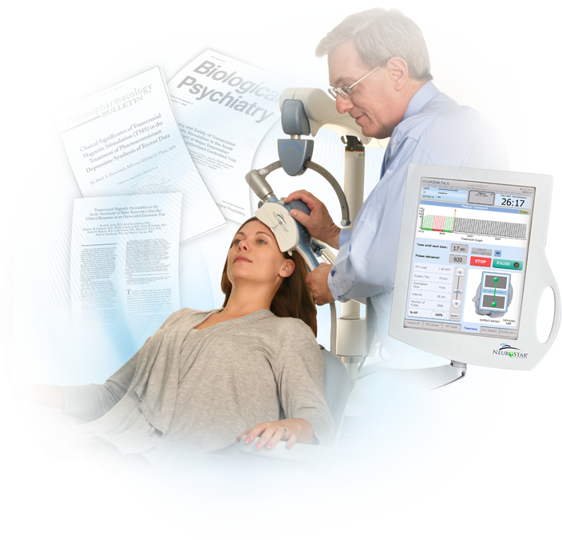
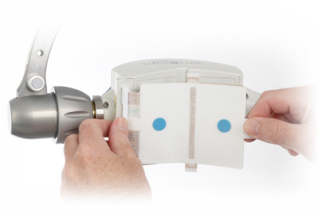
Typical TMS Course
Non-invasive
No anesthesia or sedation
Outpatient procedure
37-minute daily procedure (3000 pulses)
6-8 week treatment course
Antidepressant medication monotherapy may be used for maintenance
Notes:
2
The NeuroStar TMS Therapy system is the only FDA-cleared TMS device for the treatment of adult patients with major depression who have failed to benefit from initial treatment.
In clinical practice, TMS Therapy is:
An outpatient procedure,
It is non-invasive and non-systemic in action,
Shows a safety profile of few side effects,
Is typically performed in an outpatient setting, without need for sedation or anesthesia,
A standard treatment session is 37 minutes long, and a treatment course consists of daily (5 days per week) treatments for 4 to 6 weeks,
A physician or other clinical professional is in attendance during the treatment session, which facilitates adherence with the prescribed treatment
References:
NeuroStar TMS Therapy System User Manual. Neuronetics, Inc: Malvern, PA; 2008.

Slide 3

Clinical TMS Society’s
Consensus Practice
TMS Guidelines
Perera et al J Brain Stim 2016

Slide 4
Mechanism

Slide 5
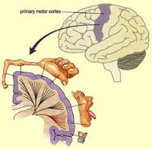
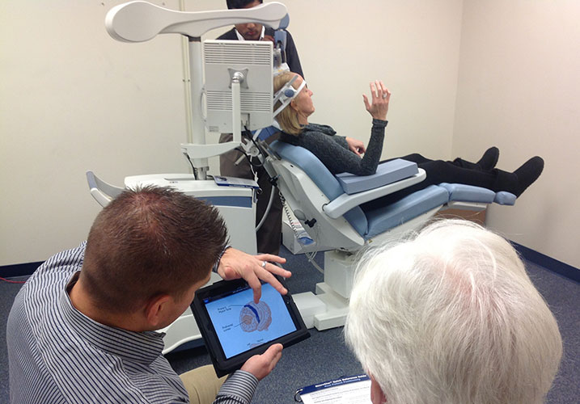
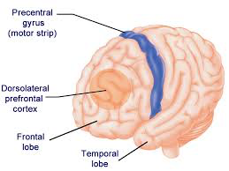
Finding DLPFC and dose

Slide 6
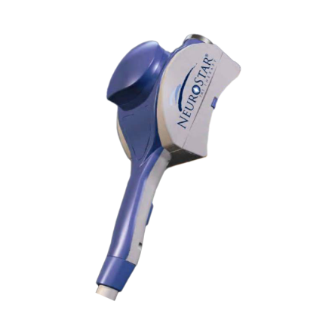
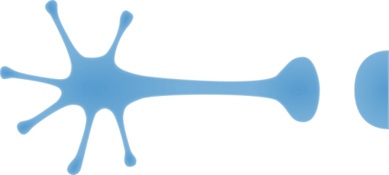
TMS effects on Neurons
Fast TMS
10-20Hz
Depolarizes Neurons
Activates Glutamate as well as serotonin, noreepinephrine, and dopamine
Causes Longterm-potentiation (LTP)
Activates hypoactive brain regions
Slow TMS
1Hz
Hyperpolraizes neurons
Activates GABA
Causes longterm Depression (LTD)
Suppresses hypeeractive brain regions
Neuron
Neurons are “electrochemical cells” and respond to either electrical or chemical stimulation
Notes:
The underlying rationale for the use of TMS exploits the fact that neurons are electrochemical cells. This means that neuronal activity can be affected either chemically, via the use of drugs, or electrically, via interventions like TMS.
Unlike drug action, whose effects tend to be anatomically diffuse, the effects of TMS are anatomically focused, and by design are non-invasive and non-systemic in action. Under normal conditions of use, TMS therefore incurs far fewer adverse events, and is devoid of undesired systemic adverse events commonly observed with antidepressant medications.
The TMS device is a powerful electromagnet, which is turned on and off in a rapid fashion, producing a pattern of “pulsed” magnetic fields. When pulsed magnetic fields are positioned close to an electrical conductor, like neurons, a local electrical current is produced in that conductor. This electric current is powerful enough right under the magnetic coil to elicit action potentials, which then travel down the neuron, ultimately causing the release of neurotransmitters at the synapse (Post 2001, p. 193A).
References:
Post A, Keck ME. Transcranial magnetic stimulation as a therapeutic tool in psychiatry: what do we know about the neurobiological mechanisms? J Psychiatric Research. 2001;35: 193-215.

Slide 7
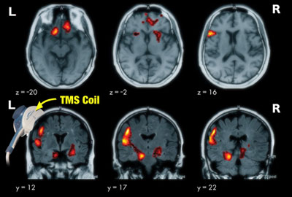
Neuroimaging Studies
NeuroStar provides targeted stimulation of brain regions involved in mood regulation without the burden of side effects
Neuroimaging studies have documented changes in cortical metabolic activity as a result of TMS therapy
Notes:
Neuroimaging studies have documented changes in cortical metabolic activity in tissue directly stimulated by TMS and in distal networks known to be involved in mood regulation.
Repeated activation of the left prefrontal cortex is known to produce antidepressant effects in patients suffering from major depression.
NeuroStar provides targeted stimulation of the brain regions involved in mood regulation without the burden of systemic side effects.

Slide 8
Clinical Studies of TMS

Slide 9
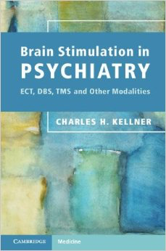
Summary of Outcomes of RCT studies
Three large, multisite, randomized controlled trials
Aggregate number of patients 709
Number of Antidepressant Failures 1-4
Treatment Duration 4-6 weeks
Response Rates 55-63%
Net incidence of illness relapse under 6-months was: 11%

Slide 10
TMS Safety

Slide 11
Summary
No systemic side effects
No adverse effect on cognition
Most common adverse event associated with treatment was scalp pain or discomfort
  < 5% of patients discontinued due to adverse events
No seizures with NeuroStar device during clinical studies
  (over 10,000 treatments)
Rare risk of seizure with NeuroStar TMS in post-market use (0.003% per treatment, <0.1% per acute treatment course)
  (1 in 100,000 treatments in post-marketing experience to date)
Long term safety demonstrated in 6 months follow-up
Notes:
An overall summary of the main safety findings are shown on this slide. As I discussed earlier, TMS showed no systemic side effects.
There were no adverse effects on cognition as measured by formal cognitive testing using the Mini Mental Status Examination (a measure of global cognitive function), the Buschke Selective Reminding Test (a measure of short-term memory), and the Autobiographical Memory Interview Short Form (a measure of long-term memory).
The most commonly reported device-related adverse event was scalp pain or discomfort in about a third of all patients.
Only about 5% of patients discontinued treatment due to adverse events, and for the majority of patients, the device-related adverse events subsided substantially after the first week of treatment.
Long term safety was confirmed in a six month period of follow up after benefit from acute treatment.
Seizure is the major, medically significant potential safety risk of TMS. During clinical trials, no seizures were observed with the NeuroStar TMS system. In post-market use, the risk of seizure is rare. Since market introduction and based on current usage, an estimated risk of seizure is approximately 0.003% per treatment exposure, and <0.1% per acute treatment course. To date, over 150,000 treatments and more than 5,000 patients have been treated with the NeuroStar TMS Therapy system which confirms its safe use in the treatment of depression.

Slide 12

Contraindications
Implanted metallic devices in or around the head
Device implants such as deep brain stimulators, cochlear implants, and vagus nerve stimulators
Notes:
NeuroStar TMS Therapy is contraindicated in patients with implanted metallic devices or non-removable metallic objects in or around the head or for patients who have certain device implants such as deep brain stimulators, cochlear implants and vagus nerve stimulators.
NeuroStar TMS Therapy should be used with caution in patients with implants controlled by physiological signals. This includes pacemakers and implantable cardioverter defibrillators (ICDs).

Slide 13
Reimbursement

Slide 14
Insurance: CPT Category I Codes
90867
Therapeutic repetitive transcranial magnetic stimulation treatment; initial, including cortical mapping, motor threshold determination, delivery and management
90868
90869
Subsequent MT re-determination with delivery and management
Subsequent delivery and management, per session
Notes:
In 2011, the AMA CPT Editorial Panel issued the first two new Category I CPT Codes for coding of TMS Therapy services (90867 and 90868). The CPT Editorial Panel issues CPT treatment codes for newly available clinical procedures in the United States. Issuance of Category I CPT codes is a recognition that the service described has received FDA clearance, has a sufficient peer-reviewed evidence base demonstrating its efficacy and safety for its intended use, that the procedure is in widespread clinical use by physicians in the United States, and that there is support from the relevant professional societies for the proposed new CPT codes
In 2012, the CPT Editorial Panel expanded the set of Category I CPT with the addition of a third CPT code (90869). In total, these three codes address the three major components of the clinical care delivery for TMS Therapy:
CPT Code 90867 is reported once at the initiation of a course of TMS Therapy and covers the initial MT (medical technologist) determination, the mapping procedure required to determine the treatment target location, the services involved in planning the upcoming course of TMS Therapy to be delivered to the patient, and the delivery of the first treatment session
CPT Code 90868 is reported for each TMS Therapy treatment session performed, and covers the daily TMS Therapy session delivery, and the physician services associated with patient management of the TMS Therapy session itself
CPT Code 90869 is reported at any later time point during a course of treatment when the psychiatrist has determined that the motor threshold estimation procedure requires redetermination

Slide 15
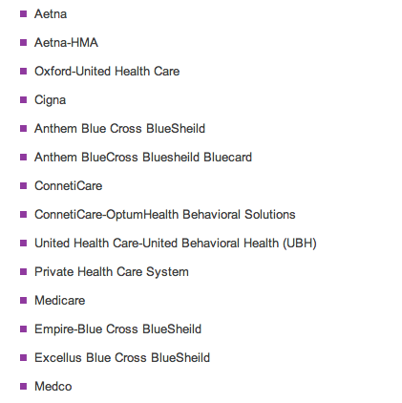
Reimbursement
100%Private Insurance and Medicare covers TMS
Notes:
We have an 80% success rate in getting reimbursement for depressed patients who have failed more than three medications.

Slide 16
Our Off-Label Use of rTMS

Slide 17
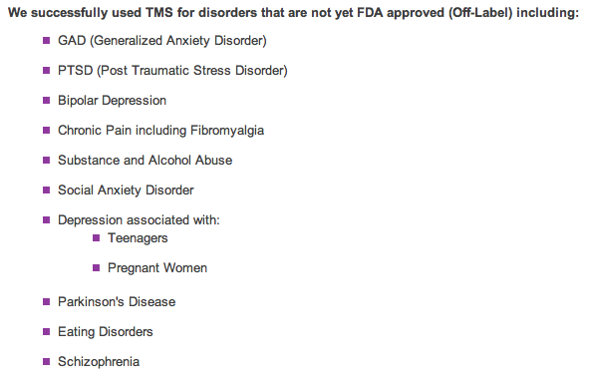
Offlabel traetemts and populations
Children
Pregnant women
Elderly
Children
Pregnant women
Elderly

Slide 18
TMS and Pain

Slide 19
Treatment Utilization and Outcomes Study
Goal
  Define real world outcomes associated with NeuroStar TMS Therapy across a broad spectrum of patients and practitioners
Patient Population & Sites
  307 evaluable unipolar, non-psychotic MDD patients in acute phase
  42 sites comprised of institutions (~20%) and private practice (~80%)
Study Design Phases
  Acute phase (clinician determined care based on clinical progress)
  Long-term outcomes at 12 months (study ongoing at present)
Patient Treatment
  Clinical care initiated per current labeled guidelines
Neuronetics, Inc. (data on file) ; clinicaltrials.gov listing number NCT 01114477
Notes:
This is a pragmatic, prospective, open-label observational study. It is sponsored by Neuronetics, and the information is being gathered from approximately 40 clinical practices throughout in the United States who are using the NeuroStar TMS Therapy system for the treatment of patients with major depression. The full information on this study is available on the public clinical trial website of the federal government, Clinical Trials.gov.
The data I will summarize are an interim analysis of the acute phase outcomes of the first 99 patients enrolled in this study. Patients were eligible for the study, if they had a clinically established diagnosis of major depression, and their treating clinician determined that NeuroStar TMS Therapy was the most appropriate next treatment option for their illness.
The outcomes measures included the clinician-rated Clinical Global Impressions-Severity of Illness Scale. Patients were asked to complete two different efficacy outcome measures, the Patient Health Questionnaire-9 Item, and the Inventory of Depressive Symptoms-Self Report.
Outcomes were obtained at baseline, during treatment and then at treatment conclusion. All treatment choices were determined by the treating physician based on the patient’s clinical condition, and were not prescribed by the protocol.

Slide 20
Quality of Life study showed improvements in pain
  307 evaluable unipolar, non-psychotic MDD patients in acute phase
  42 sites comprised of institutions Acute phase (clinician determined care based on clinical progress)
  Long-term outcomes at 12 months (study ongoing at present)
**
**
**
**
**
**
**
**
**
Norm-Based Score
Pairwise T-Test of within group change from baseline; observed case analysis, ** = P < 0.0001

Slide 21
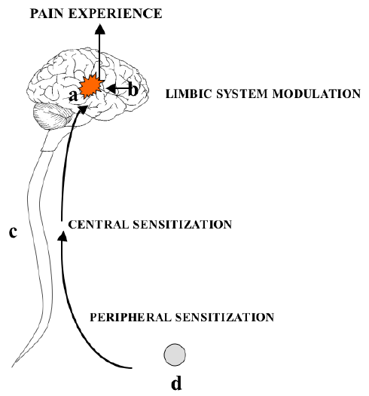
Theoretical mechanisms of analgesic effects of TMS
TMS is thought to reduce pain by:
Inhibiting regions associated with emotional response to pain such as the anterior cingulate cortex and insula.
Stimulating descending pathway inhibition at the dorsal horn level via the brai stem peraquiductal gray region.

Slide 22
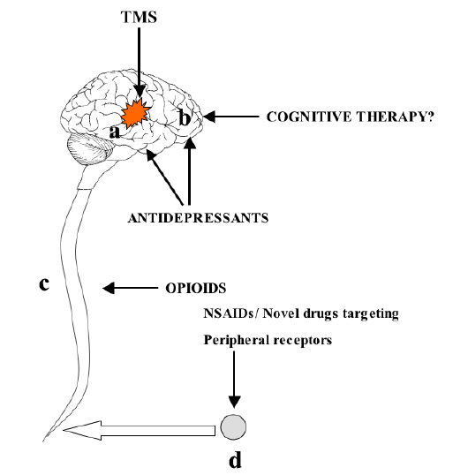
Experimental evidence
Pain involving c-fibers increases cortical excitability in the sensorimotor strip
rTMS reduces pain perception by decreasing sensorimotor excitability by:
Inhibiting sensorimotor excitability via slow 1Hz rTMS applied to the sensorimotor strip
Increasing inhibitory input from the PFC into the sensorimotor strip via rapid 10Hz rTMS applied to the DLPFC
Brain Plasticity will lead to sustained amanalgesic effects of rTMS
Fierro et al 2010 Exp Brain Res

Slide 23
Studies of TMS and Pain

Slide 24
rTMS for Suppressing Neuropathic Pain:
A Meta-Analysis
,Donohue, M et al, Journal of Pain .2009.03.010
This pooled individual data (PID)-based meta-analysis collectively assessed the analgesic effect of rTMS on various neuropathic pain states based on their neuroanatomical hierarchy. Available randomized controlled trials (RCTs) were screened. Coded pain neuroanatomical origins consist of peripheral nerve (PNnerve root (NR); spinal cord (SC); trigeminal nerve or ganglion (TGN); and post-stroke supraspinal related pain (PSP). Raw data of 149 patients were extracted from 5 (1 parallel, 4 cross-over) selected (from 235 articles) RCTs.
A significant (P < .001) overall analgesic effect (mean percent difference in pain visual analog scale (VAS) score reduction with 95% confidence interval) was detected with greater reduction in VAS with rTMS in comparison to sham. Including the parallel study (Khedr et al), the TGN subgroup was found to have the greatest analgesic effect (28.8%), followed by PSP (16.7%), SC (14.7%), NR (10.0%), and PN (1.5%). The results were similar when we excluded the parallel study with the greatest analgesic effect observed in TGN (33.0%), followed by SC (14.7%), PSP (10.5%), NR (10.0%), and PN (1.5%). In addition, multiple (vs single, P = .003) sessions and lower (>1 and ≤10 Hz) treatment frequency range (vs >10 Hz) appears to generate better analgesic outcome.
In short, rTMS appears to be more effective in suppressing centrally than peripherally originated neuropathic pain states.

Slide 25

rTMS for lower back pain
Bioelectromagnetics. 2016 Aug 22. doi: 10.1002/bem.22001. [Epub ahead of print]
Analgesic effect of repetitive transcranial magnetic stimulation (rTMS) in patients with chronic low back pain. Ambriz-Tututi et al
The objective of the present study was to assess the benefits of 1-week repetitive transcranial magnetic stimulation (rTMS) in patients with chronic low back pain (LBP).
The visual analogue scale (VAS), Short Form McGill pain questionnaire (SF-MPQ), and Short Form 36 Health Survey were used to evaluate the effect of this treatment.
Eighty-two patients diagnosed with LBP were divided randomly into three groups: rTMS-treated group, sham group, and physical therapy-treated group.
We observed a significant reduction in VAS and SF-MPQ scores in the rTMS-treated group, but not in the sham group. Moreover, patients who received rTMS had a lower mean pain score than patients treated with physical therapy.
Our study suggests that rTMS produces safe, significant, and long-term (1 month) relief in patients with LBP without evident side effects. This study shows for the first time that long-term repeated sessions of rTMS decrease pain perception of LBP.

Slide 26
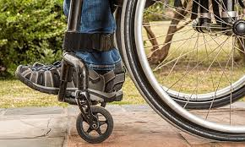
rTMS in Spinal Cord Injury
rTMS of the prefrontal cortex has analgesic effects on neuropathic pain
in subjects with spinal cord injury.
Randomized controlled trial Nardone R, et al. Spinal Cord. 2017.
In this study, we performed PMC/DLPFC rTMS in subjects with SCI and neuropathic pain. Twelve subjects with chronic cervical or thoracic SCI were randomized to receive 1250 pulses at 10 Hz rTMS (n=6) or sham rTMS (n=6) treatment for 10 sessions over 2 weeks. The visual analog scale, the sensory and affective pain rating indices of the McGill Pain Questionnaire (MPQ), the Hamilton Depression Rating Scale and the Hamilton Anxiety Rating Scale were used to assed pain and mood at baseline (T0), 1 day after the first week of treatment (T1), 1 day (T2), 1 week (T3) and 1 month (T4) after the last intervention.
Subjects who received active rTMS had a statistically significant reduction in pain symptoms in comparison with their baseline pain, whereas sham rTMS participants had a non-significant change in daily pain from their baseline pain.
The findings of this preliminary study in a small patient sample suggest that rTMS of the PMC/DLPFC may be effective in relieving neuropathic pain in SCI patients.

Slide 27
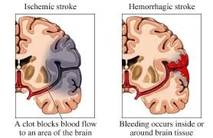
rTMS Post Stroke Pain
rTMS once a week induces sustainable long-term relief of central poststroke pain.
Kobayashi et al. Neuromodulation. 2015
Eighteen patients with central poststroke pain were included in this study. rTMS (10 trains of 10-sec 5 Hz-rTMS) was delivered over the primary motor cortex on the affected side. The rTMS session was repeated once a week for 12 weeks, and for six patients the intervention was continued for one year. The degree of the pain was assessed before each weekly rTMS session to evaluate sustainable effects.
The effects of the rTMS reached a plateau at the eighth week. At the 12th week, the rTMS was effective in 61.1% of the patients; 5 of the 18 patients showed more than 70% reduction based on a visual analog scale, 6 patients showed 40-69% reduction, and 7 remained at a pain reduction level of less than 40%. When patients were divided into two groups with or without severe dysesthesia, it was found that eight patients with severe dysesthesia showed less pain relief than those without. In the six patients who continued rTMS for one year, the pain relief effects also were sustained.
Although this was an open-label study without a control group, our findings suggest that rTMS of the primary motor cortex, when maintained once a week, could help to relieve poststroke pain.

Slide 28
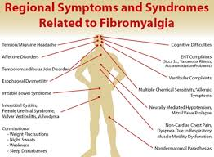
rTMS for Fibromyalgia
Repetitive Transcranial Magnetic Stimulation for Fibromyalgia:
Systematic Review and Meta-Analysis.
Knijnik LM, et al. Pain Pract. 2016.
To evaluate the efficacy of rTMS on Fibromylagia (FM), a comprehensive systematic review and meta-analysis were performed.
Relevant published, English and Portuguese language, randomized clinical trials (RCT) comparing rTMS (irrespective of the stimulation protocol) to sham stimulation for treating FM pain intensity, depression, and/or quality of life (QoL) were identified, considering only those with low risk for bias. Trials available until April 2014 were searched through MEDLINE, EMBASE, the Cochrane Library Databases, and other 26 relevant medical databases covering from every continent. The outcomes for pain, depression, and QoL assessed closest to the 30th day after rTMS treatment were extracted, and changes from baseline were calculated to compare the effects of rTMS vs. placebo.
One hundred and sixty-three articles were screened, and five with moderate to high quality were included. rTMS improved QoL with a moderate effect size (Pooled SMD = -0.472 95%CI = -0.80 to -0.14); it showed a trend toward reducing pain intensity (SMD = -0.64 95%CI = -0.31 to 0.017), but did not change depressive symptoms.
In comparison with sham stimulation, rTMS demonstrated superior effect on the QoL of patients with FM 1 month after starting therapy

Slide 29
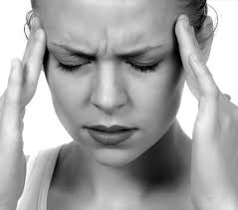
rTMS for migraines
Efficacy of Noninvasive Brain Stimulation on Pain Control in Migraine Patients:
A Systematic Review and Meta‐Analysis Shirahige - 2016 - Headache: The Journal of Head and Face Pain
To evaluate the efficacy of noninvasive brain stimulation (NIBS) on pain control in migraine patients.
Searches were conducted in six databases: MEDLINE (via PubMed), LILACS (via BIREME), CINAHL (via EBSCO), Scopus (via EBSCO), Web of Science, and CENTRAL. Two independent authors searched for randomized controlled clinical trials published through until January 2016 that involved the use of transcranial direct current stimulation (tDCS) and transcranial magnetic stimulation (TMS) in migraineurs.
Eight studies were included in the quantitative analysis with 153 migraine patients that received NIBS and 143 sham NIBS. In overall meta‐analysis, we did not find significant results for pain intensity. However, subgroup analysis considering only tDCS effects have demonstrated a decrease for pain intensity (SMD: −0.91; 95% CI: −1.79 to −0.03; P = .04), migraine attacks (SMD: −0.75; 95% CI: −1.25 to −0.24; P = .004), and painkiller intake (SMD: −0.64; 95% CI: −1.21 to −0.07; P = .03).
Subgroup analysis for TMS did not reveal significant effects for any outcome.
Low or very low quality of evidence suggests that our primary outcome evaluation failed to find support for the superiority of NIBS over sham treatment. Although, subgroup analysis reveals that tDCS have moderate to high effects and could be a promising nonpharmacological alternative to pain control, mainly for painkiller intake reduction. However, there is a need for larger controlled trials with methodological rigor, which could increase the power of result inference.

Slide 30

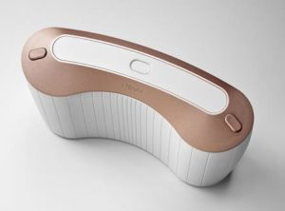
Single pulse TMS treatment of migraines
FDA approved 2017
The efficacy of transcranial magnetic stimulation on migraine: a meta-analysis of randomized controlled trails
Lihuan Lan et al , 2017 J Headache Pain
This article was aimed to assess the efficacy of TMS on migraine based on randomized controlled trails (RCTs).
Methods
We searched PubMed, Embase and Cochrane Library electronic databases for published studies which compared TMS group with sham group, conducted a meta-analysis of all RCTs.
Results
Five studies, consisting of 313 migraine patients, were identified. Single-pulse transcranial magnetic stimulation is effective for the acute treatment of migraine with aura after the first attack (p = 0.02). And, the efficacy of TMS on chronic migraine was not significant (OR 2.93; 95% CI 0.71–12.15; p = 0.14).
Conclusions
TMS is effective for migraine based on the studies included in the article.

Slide 31
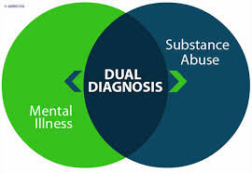
TMS treatment in patients with Depression and Opioid Abuse

Slide 32
Conclusion
rTMS is a safe non invasive treatment that shows benefits in central neuropathic pain
However, RCT studies and longterm durability of analgesic effects are yet to be studied

